Slide 1


How to Enhance that UI with PCF
Rami Mounla
Solution Architect | Power Platform | DXC NZ

Slide 2
You, Me, and the Power Platform

Slide 3






Slide 4
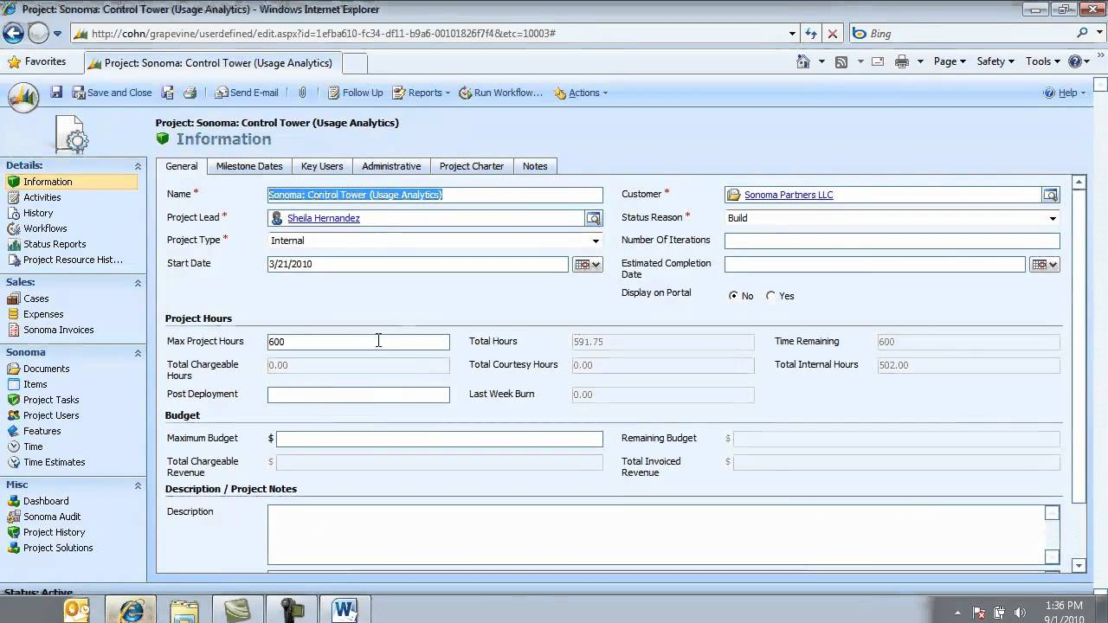

Slide 5
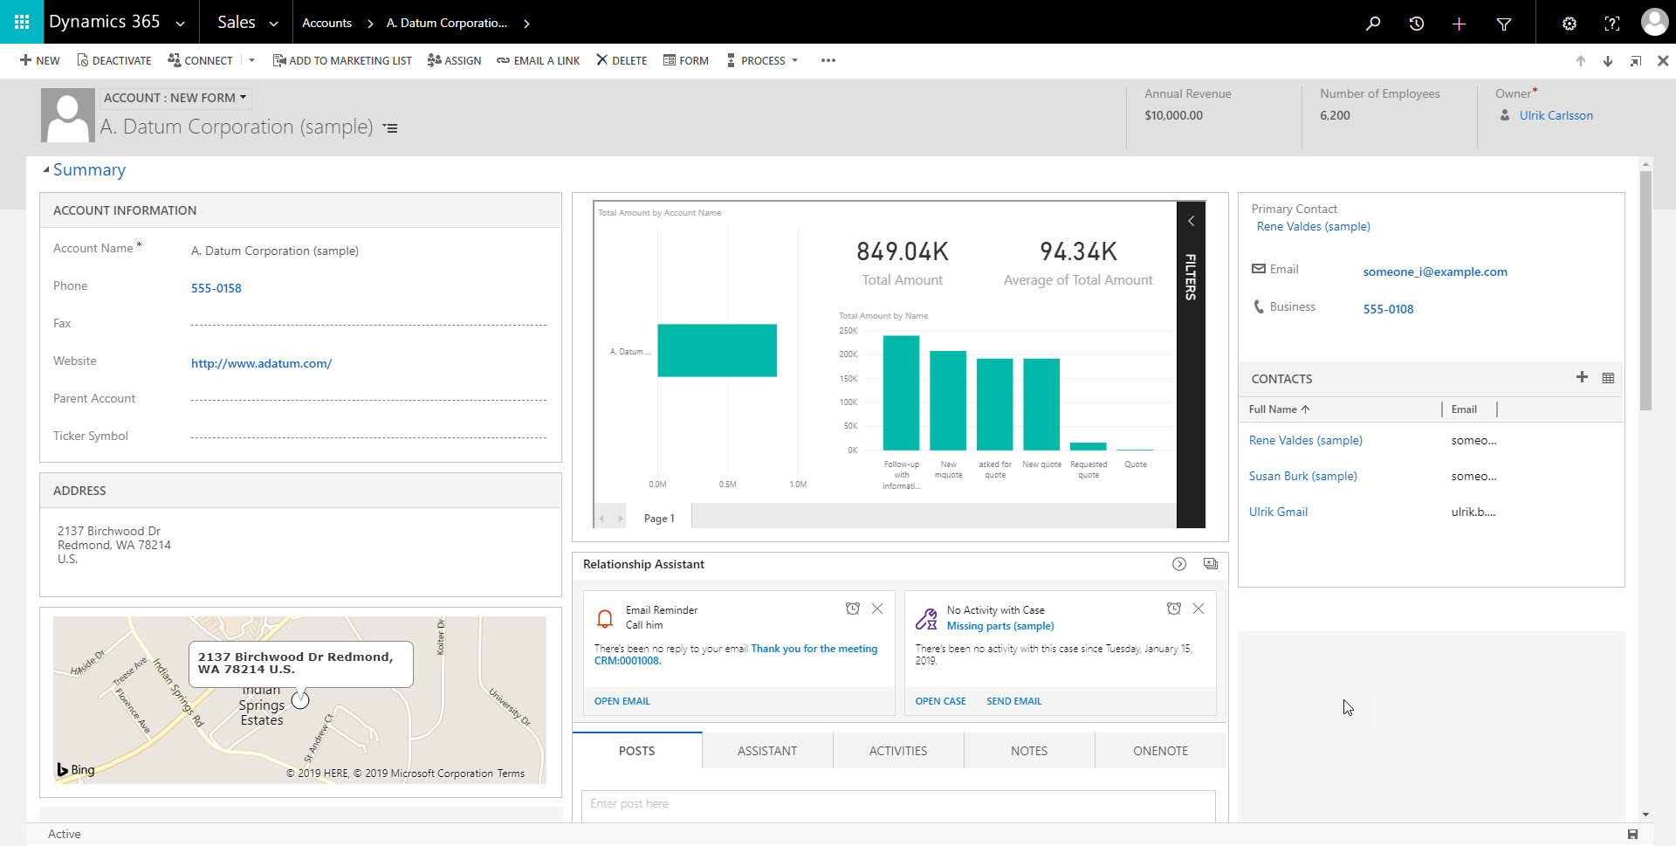

Slide 6
What is the Power Platform Component Framework?

Slide 7
Power Apps component framework empowers professional developers and app makers to create code components for model-driven and canvas apps (experimental preview) to provide enhanced user experience for the users to work with data on forms, views, and dashboards.

Slide 8
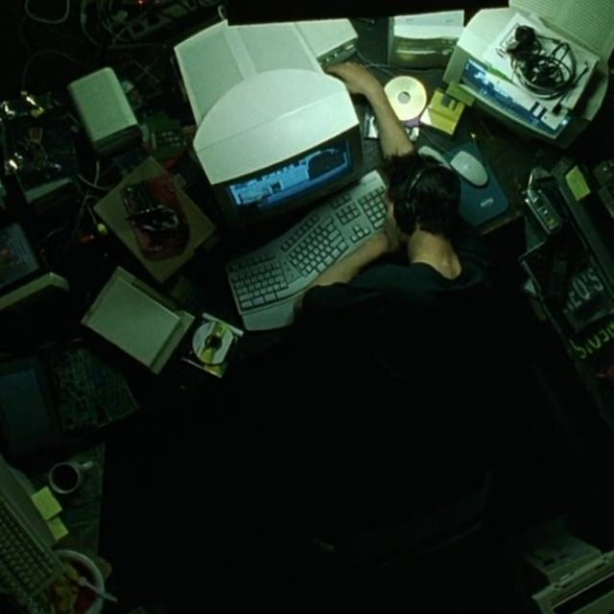

Slide 9
Examples

Slide 10
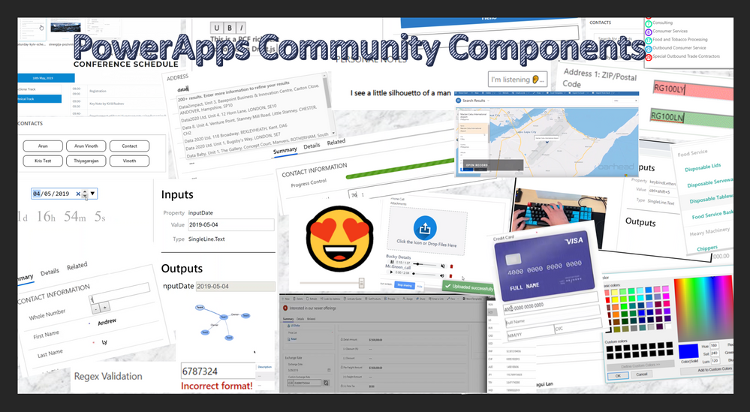

Slide 11
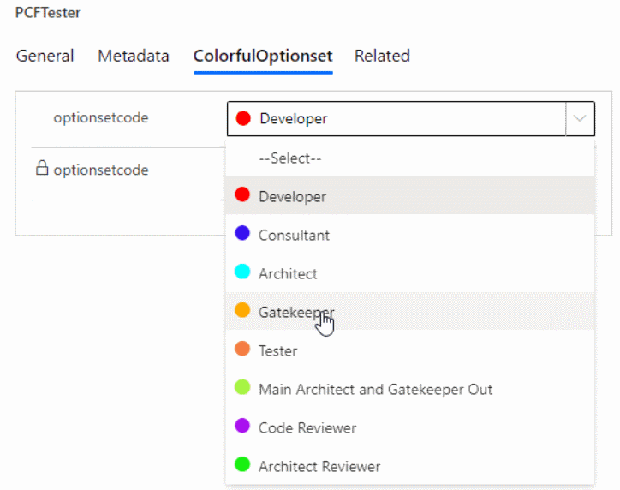

Slide 12
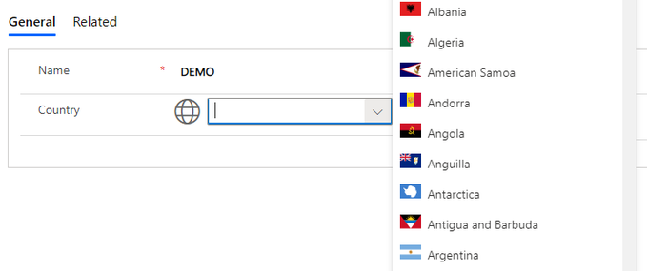

Slide 13
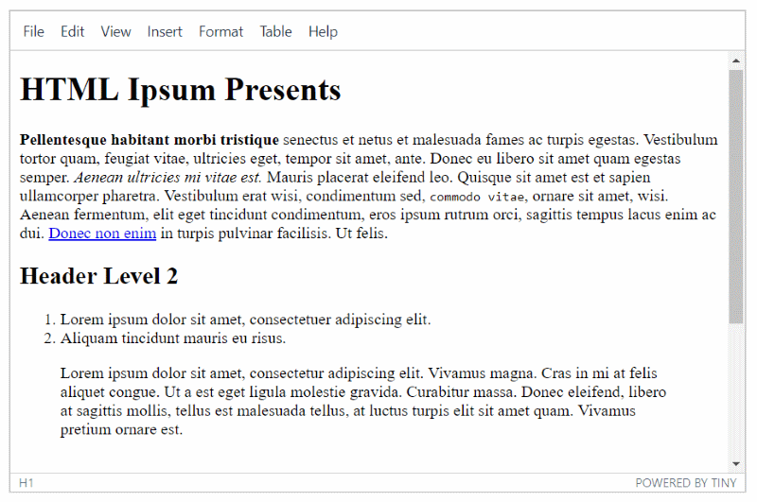

Slide 14
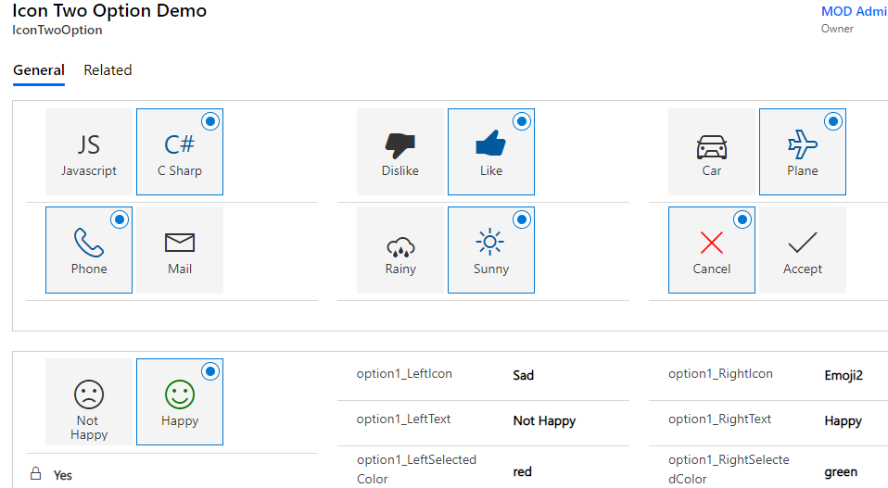

Slide 15
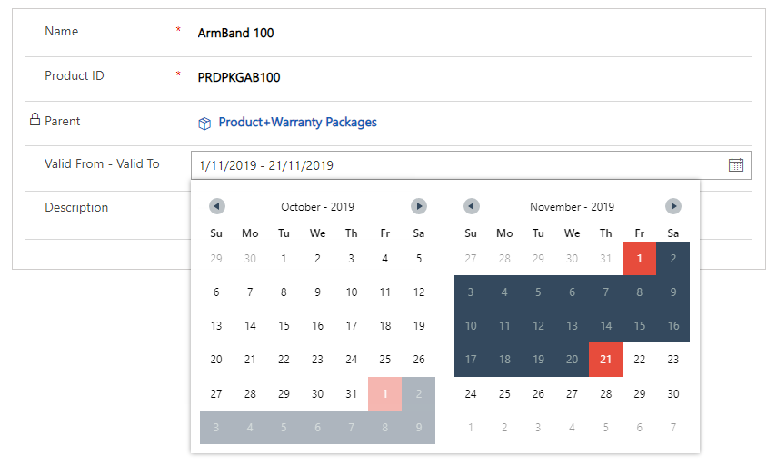

Slide 16
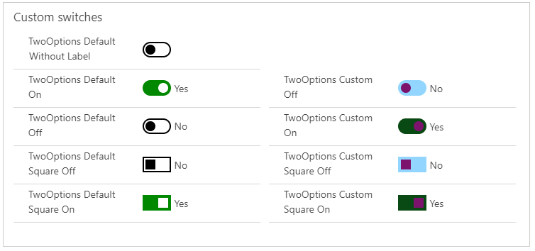

Slide 17
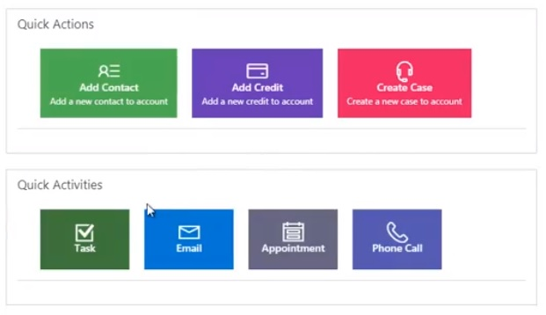

Slide 18
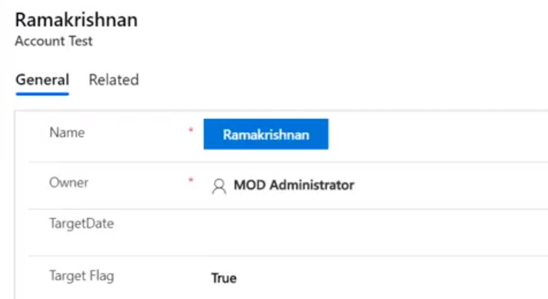

Slide 19
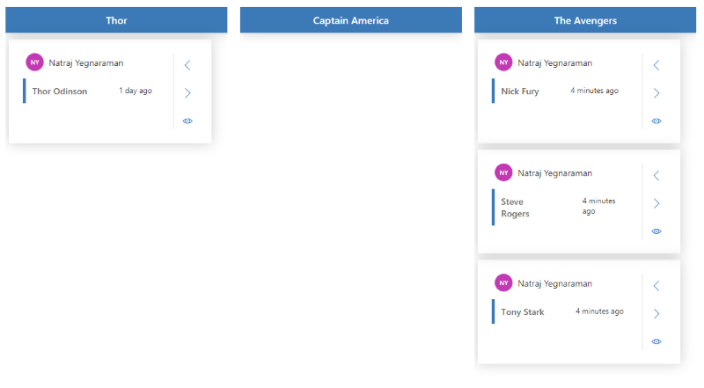

Slide 20
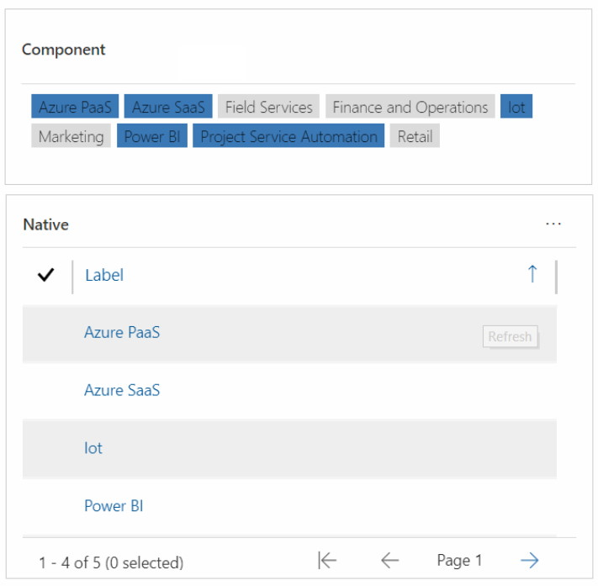

Slide 21
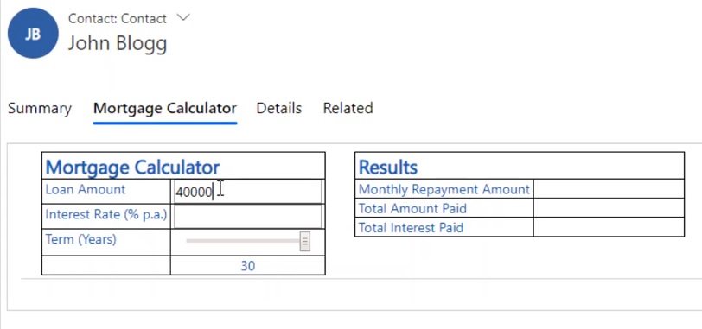

Slide 22
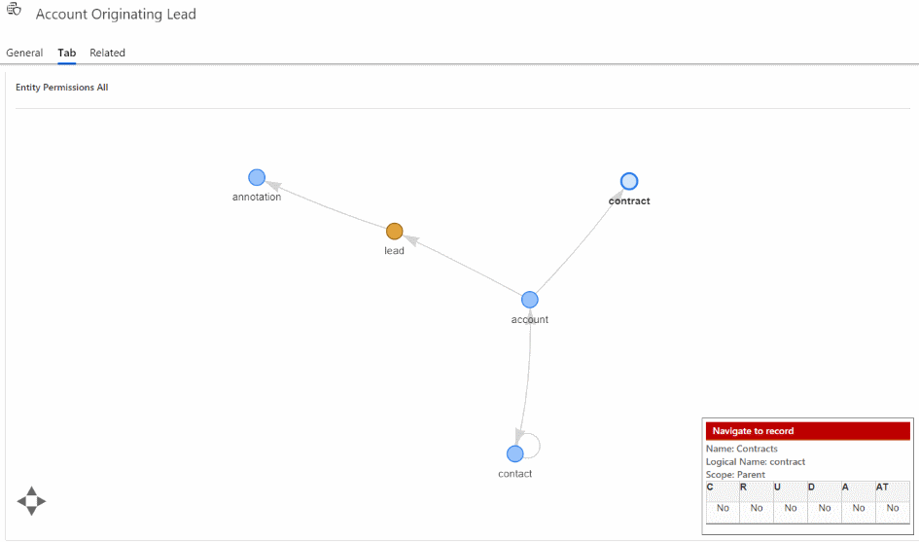

Slide 23
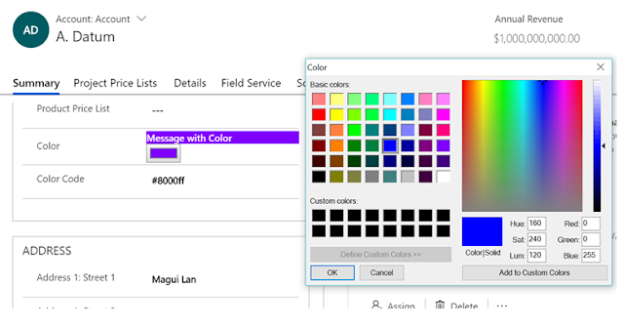

Slide 24
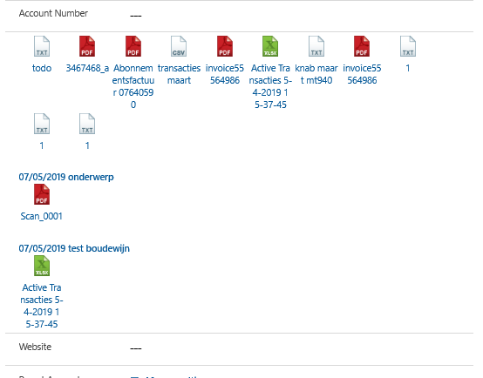

Slide 25
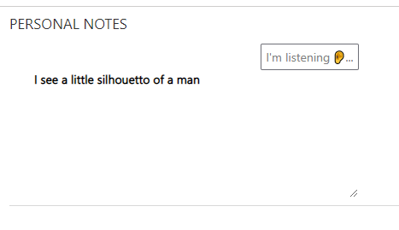

Slide 26
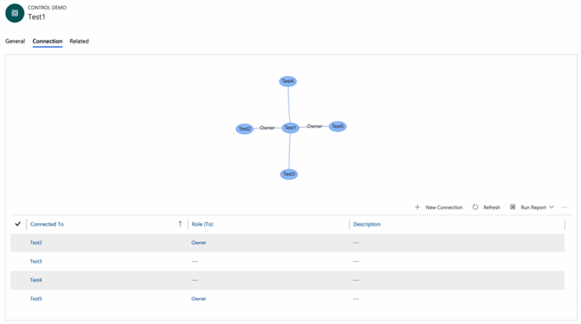

Slide 27
NZ specific ones

Slide 28
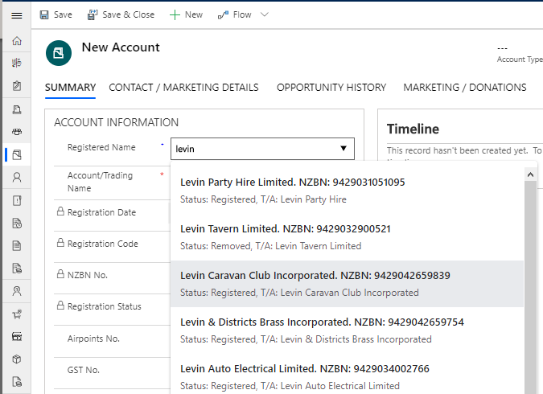

Slide 29
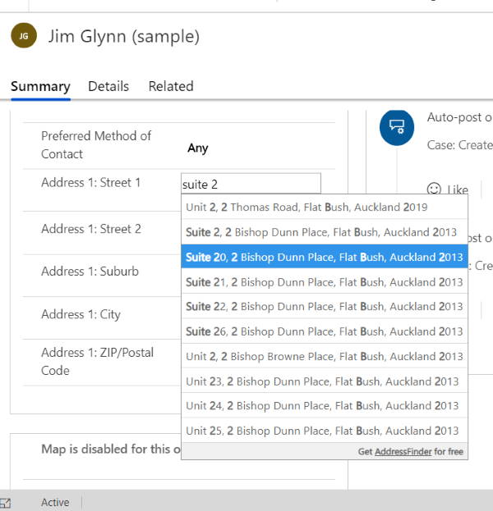

Slide 30

Hemant Gaur
1300+ non-msft in prod
140 open source on PCF Gallery

Slide 31

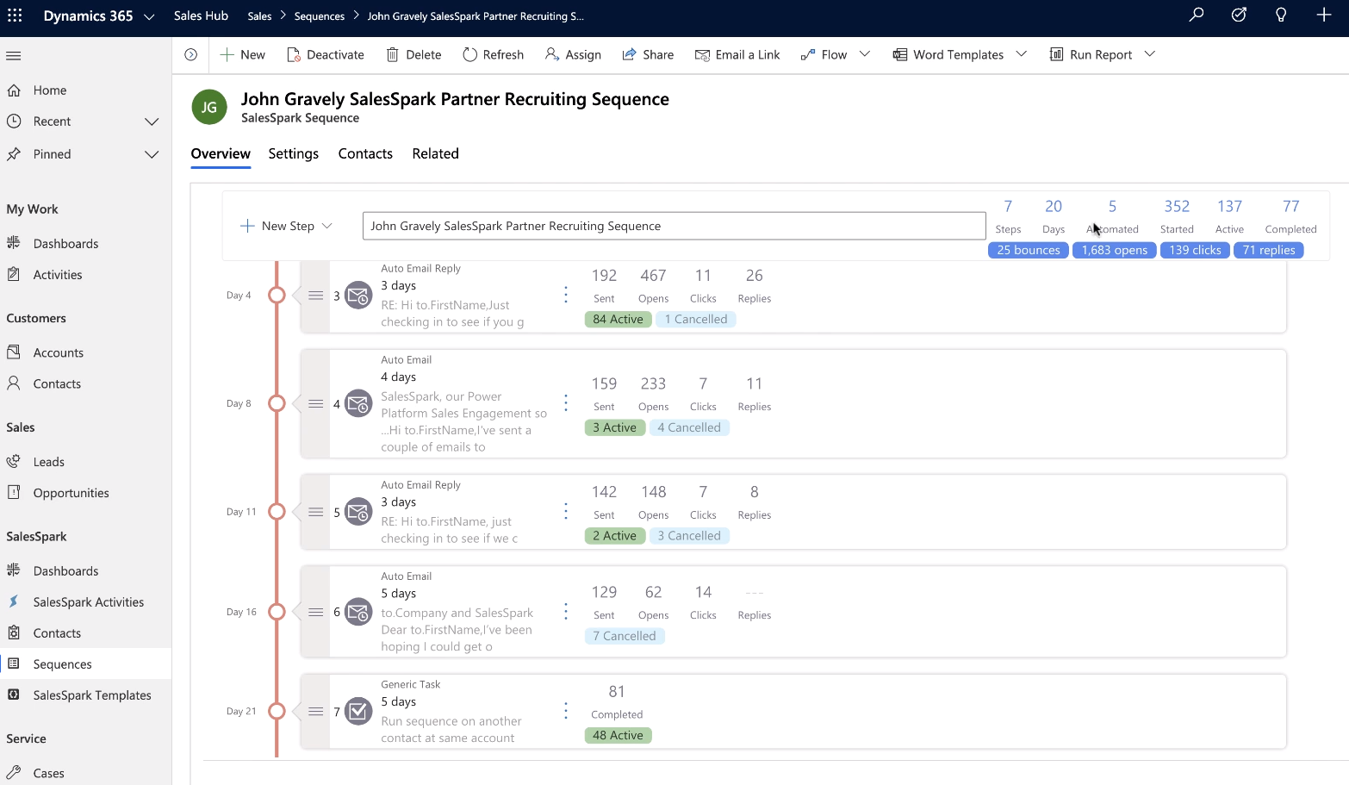

Slide 32
Field v Data Sets

Slide 33
Learning Curve
What you need to know

Slide 34
Technologies
NPM
TypeScript
HTML + CSS

Slide 35


Slide 36
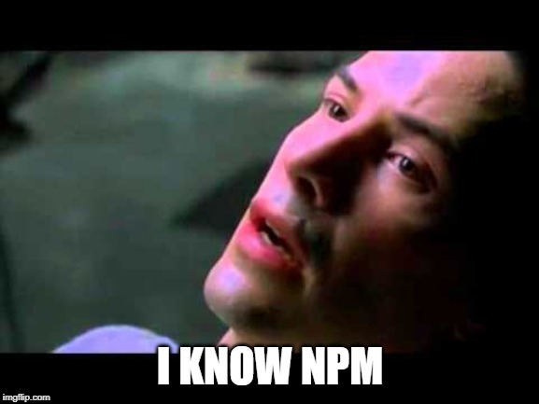

Slide 38
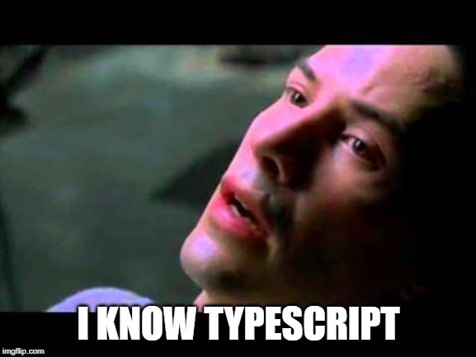

Slide 39
Getting Started

Slide 40
Prerequisites
NPM (from comes with Node.js)
.NET Framework 4.6.2 Developer Pack
Power Apps CLI

Slide 41
The 8 Commands
That you really need to know

Slide 42
Cheat Sheet Create Control
pac pcf init --namespace XrmEnterprise --name CalendarView --template dataset
1. pac pcf init --namespace XrmEnterprise --name Tile --template field
2. npm install
3. npm run build
4. npm start

Slide 43
Cheat Sheet Package Control
5. pac solution init --publisher-name XrmEnterprise --publisher-prefix xe
6. pac solution add-reference --path ..\CalendarView
7. msbuild /t:restore
8. msbuild

Slide 44
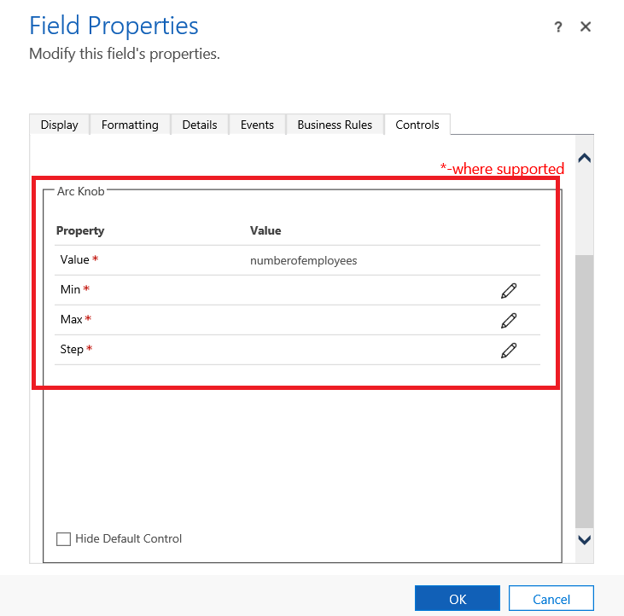

Slide 45
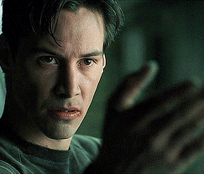

Slide 46
The Structure
That you really need to know

Slide 47
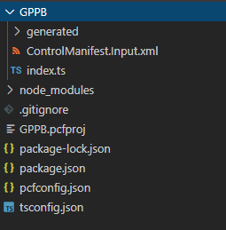

Slide 48


Slide 49
Example: Field

Slide 50
Example: Dataset

Slide 51
My Examples

Slide 52
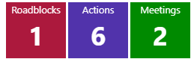

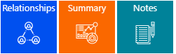

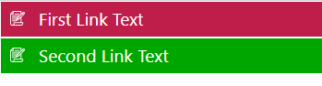

Slide 53
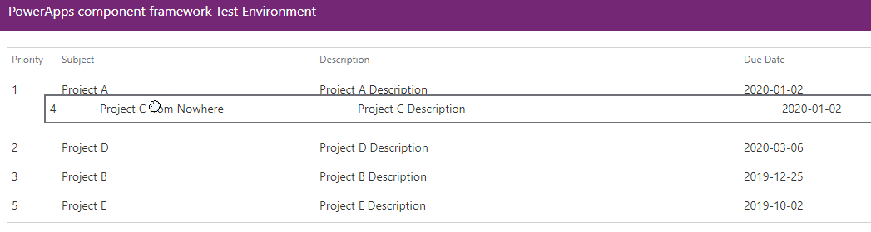

Slide 54
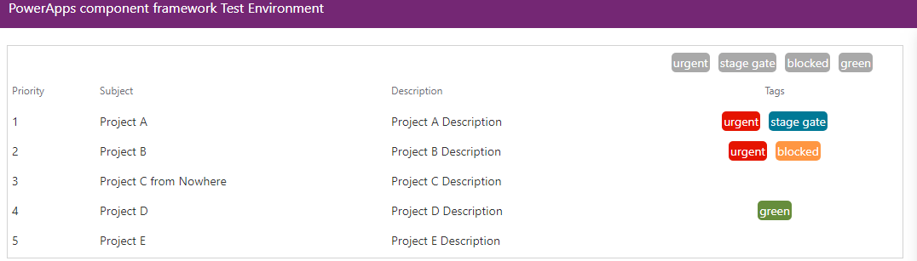

Slide 55
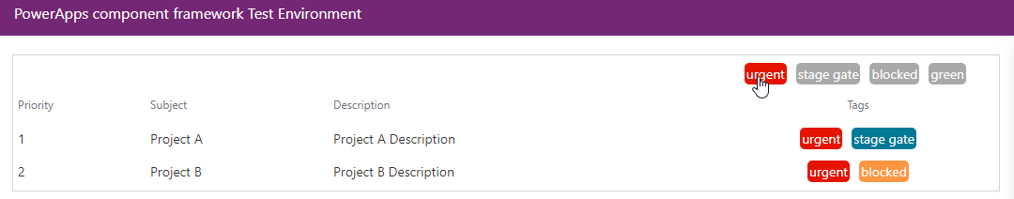

Slide 56
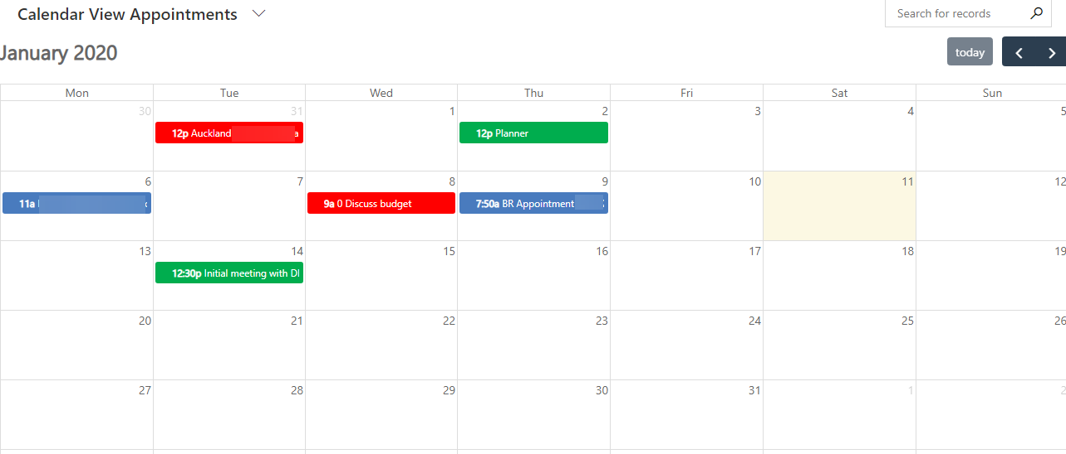

Slide 57
Improvements

Slide 58
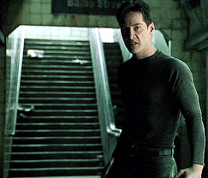

Slide 59
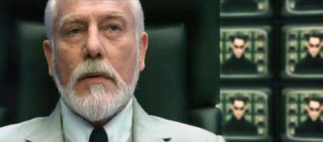
Useful links
Microsoft Documentation
https://docs.microsoft.com/en-us/powerapps/developer/component-framework/overview
Rami’s Samples
https://github.com/ramimounla
PCF Gallery
https://pcf.gallery/
Andrew Butenko
https://www.youtube.com/channel/UCjXCqDkRAGFAtu2JlWr3Epg
XrmToolbox
https://www.xrmtoolbox.com/plugins/Maverick.PCF.Builder/

Slide 60


Slide 61

Thank you

